Slide 1
Collect Earth – Training Plots
Augmented Visual Interpretation
Learning by example

Slide 2

Before you start
This presentation complements the Collect Earth survey that is shown the first time Collect Earth is run after installation. This survey is also available HERE
The examples on the coming slides are shown on the Google Earth interface when Collect Earth is loaded with the survey. Try to visualize them while you read this guide.
Collect Earth requires the user to have the latest version of Chrome installed, please make sure you do! Also, if you don't have Google Earth installed you are in the wrong presentation
It is not easy to understand the mechanism of the interpretation on the first plots, try to connect what you see in the Google Earth Very High Resolution imagery to the False Color imagery to better understand how the land cover is being visualized.

Slide 3
Table of contents
Background information:
What is the Normalized Difference Vegetation Index (NDVI)?
What is a False Color Image?
Why do we need the GEE app?
Which satellite images and graphics can you find in the GEE app?
How to activate historical images in the Google Earth interface?
Training plots:
Examples of land uses based on the IPCC land use categories (Forest, Cropland, Grassland, Wetland, Settlement, Other land) will be presented and discussed.
Plots are distributed in BEGINNER and ADVANCED plots depending on their level of difficulty.

Slide 4
Training plots
Forest:
Broadleaf evergreen - (Corcovado, Costa Rica)
Broadleaf deciduous - (Sinaloa, Mexico)
Broadleaf mixed - (Cuvette, Congo)
Mixed forest (brod-con) - (Hokkaido, Japan)
Riparian forest - (Alfeiós, Greece)
Mangrove forest - (Mekong Delta, Vietnam)
Cropland:
Rice paddy - (Biliran, Philippines)
Permanent crop, Sugarcane - (Corozal, Belize)
Orchard, Vineyard - (Kakheti, Georgia)
Permanent crop, Cereal - (Guadalajara, Spain)
Palm - (West Sepik, PNG)
Grassland:
Grassland with trees and shrubs - (Western Rwanda, Rwanda)
Grassland - (Southland, New Zealand)
Grassland with trees - (Serengeti, Tanzania)
Shrubland - (La Palma, Spain)
Grassland with trees - (Mato Grosso, Brazil)
Wetland:
Lagoon - (Rio de Janeiro, Brazil)
Seasonal river - (Ghaggar, India)
Permanent river - (Nyabarongo, Rwanda)
Salt extraction - (Qoqek, China)
Peatland - (Muyaga, Rwanda)
Settlement:
City - (Essaouira, Morocco)
Infrastructure - (Hamburg, Germany)
Mining - (North Rhine Westphalia, Germany)
Village - (Island, Lake Chad)
Urban Park - (London, UK)
Otherland:
Snow - (Arusha, Tanzania)
Sand - (Easter Island, Chile)
Dune - (Mingsha Shan, China)
Ice - (Graham Land, Antarctica)
The KML (Google Earth file) with all these plots can be found here HERE

Slide 5
What is the Normalized Difference Vegetation Index (NDVI)?
The NDVI quantifies vegetation by measuring the difference between near-infrared (which vegetation strongly reflects) and red light (which vegetation absorbs). These bands are present on the imagery collected by the MODIS, Landsat and Sentinel sensors.
NDVI = (NIR – Red) / (NIR + Red)
Calculations of NDVI for a given pixel always result in a number that ranges from minus one (-1) to plus one (+1)
No vegetation (trees of grass) gives a value close to zero
A zero means no vegetation
Close to +1 (0.8 - 0.9) indicates the highest possible density of green leaves
A negative value indicates the presence of water, snow or ice

Slide 6
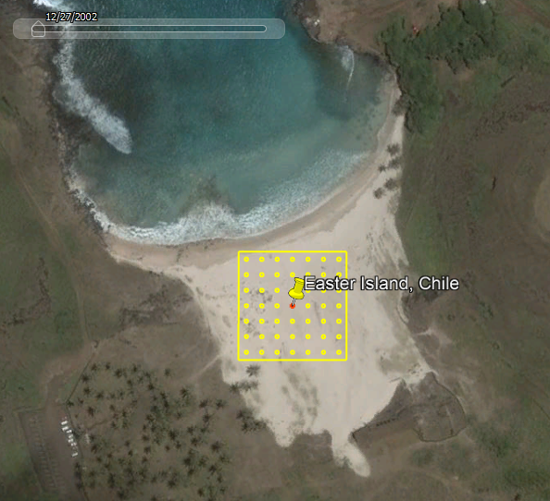
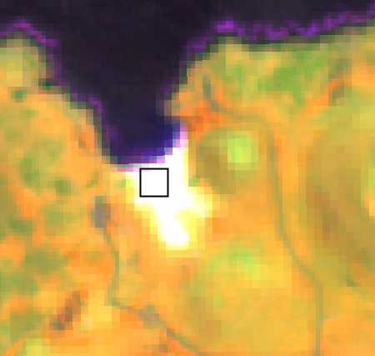
What is a False Color image?
Instead of using the human-visible bands (Red-Green-Blue) these images show a composition of Near Infrared, Short Wave Infrared and Red (NIR-SWIR-Red) bands.
This band combination allows the vegetation to be shown more prominently.
Using this False Color combination the highly vegetated areas (forest) will be shown with different shades of red/orange, the less vegetated areas (open forest and grasslands) as shades of orange/yellow and areas of very little vegetation as shades of green/blue. Water will be represented in black/dark blue.
Areas with wet terrain or snow/ice will be shown purple/pink
In the coming slides you will be able to see the different ways that this false color combination behaves depending on the land cover.
Image with human visible bands
Image with false color bands

Slide 7
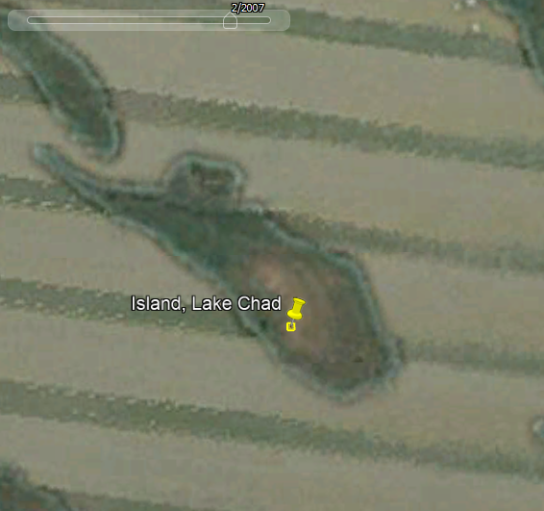
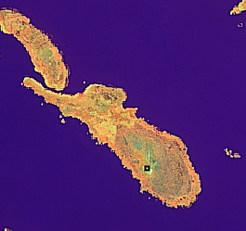
Why do we need the GEE app?
Google Earth has a historical repository of Very High Resolution (VHR) imagery that usually makes visual interpretation easy.
But this repository is limited, some areas will have dozens of VHR images while others will have one or none.
The GEE App integration allows Collect Earth to give the user a historical perspective of the changes in the landscape as the MODIS, LANDSAT 7/8 and Sentinel-2 imagery is collected globally and systematically.
Being able to access the NDVI graphs and False Color images allows the user to really understand the dynamics of the plot.
Image with human visible bands
Image with false color bands

Slide 8
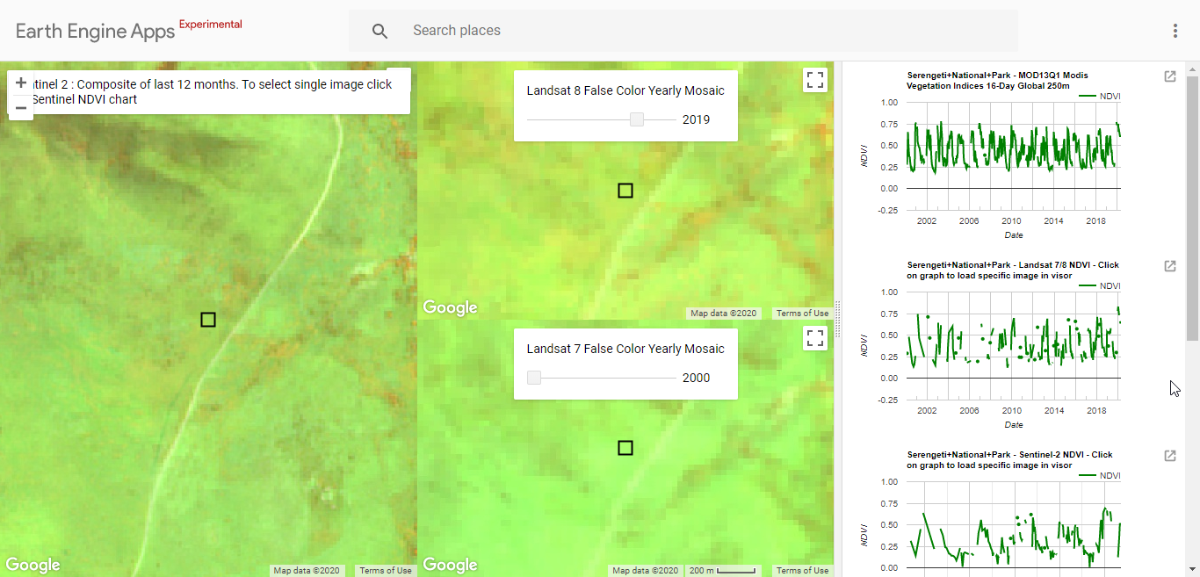
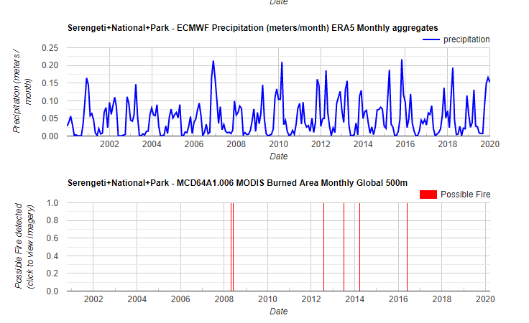
Which satellite images and graphics can you find in the GEE app?
Images: Sentinel 2 and Landsat 7/8 False Color Mosaics (NIR-SWIR-Red)
NDVI graphs: MODIS, Landsat 7/8 and Sentinel-2 NDVI (vegetation index showing the vegetation intensity)
Precipitation graph: Representation of precipitation. ECMWF Precipitation in (meters/month) - ERA5 Monthly aggregates. The precipitation should influence the variation of the NDVI.
Fire graph (MODIS): Representation of possible fires with MODIS Burned Area Monthly Global 500m

Slide 9
Which satellite images and graphics can you find in the GEE app?
Spatial and temporal resolution of satellite images:
Satellite | Spatial resolution | Temporal resolution | Imagery available since
MODIS | Low (250 m) | High (daily revisit time, graph shows less-cloudy image during16 days) | 2000
Landsat 7/8 | High (30m) | Low (16 days revisit time) | 2000
Sentinel 2 | High (20m) | High (5 days revisit time) | 2015

Slide 10
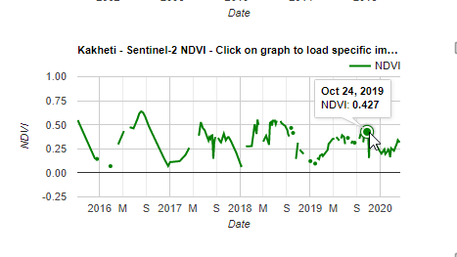
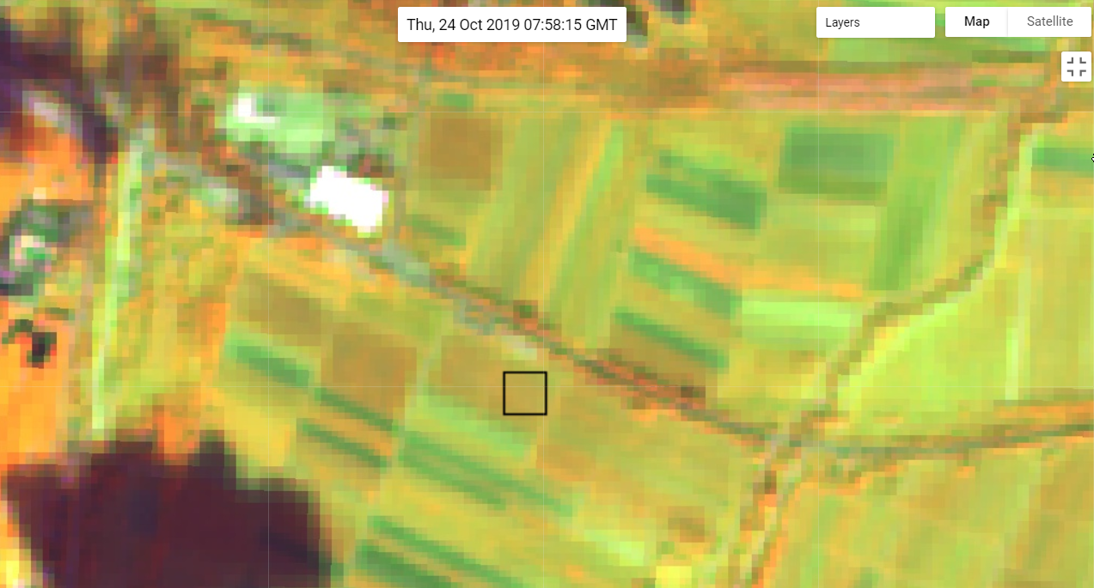
Which satellite images and graphics can you find in the GEE app?
The graphs and the images are connected. Clicking on a certain date in the graph the image of the same day will appear.
But they are not showing the same information!!
The graphs display NDVI values and the false color mosaics show the vegetation intensity.

Slide 11
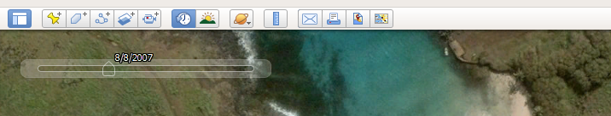
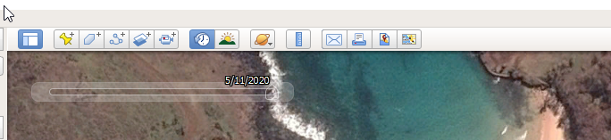
How to activate historical images in Google Earth?
Show historical imagery. Use the time slider to move between acquisition dates.

Slide 12
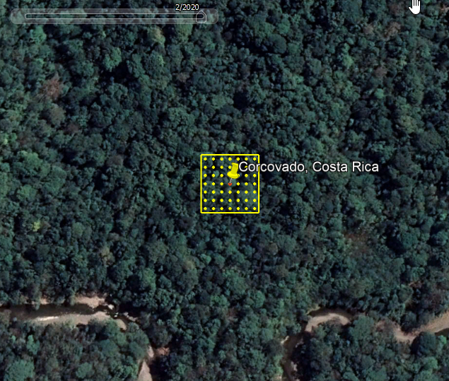

Forest - Broadleaf evergreen (Corcovado, Costa Rica)
Category: Forest
Subcategory: Broadleaf evergreen
Description: In the plot and surroundings a dense forest can be seen. The plot is in Corcovado, one of the most important and untouched protected areas in Pacific Costa Rica established in 1975.
Year 2020
View in Google Earth
BEGINNER PLOT

Slide 13
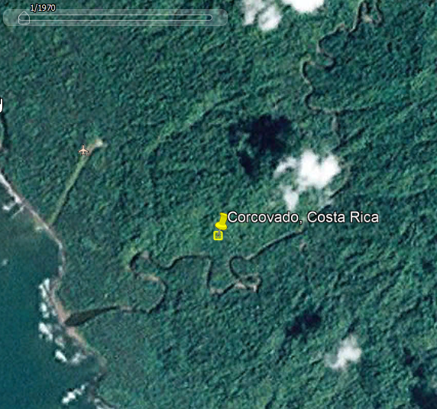
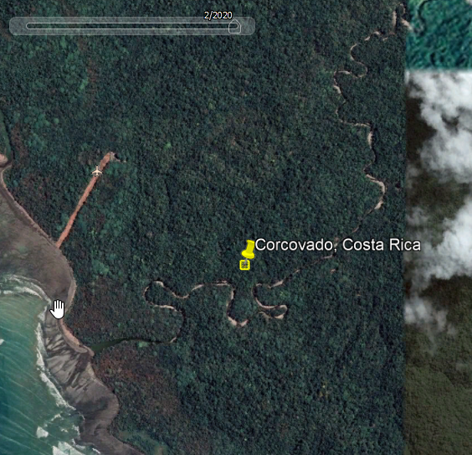
Forest - Broadleaf evergreen (Corcovado, Costa Rica)
Year 1970
Year 2020
Land use change: Since1970 no changes perceived in terms of forest area and density.

Slide 14
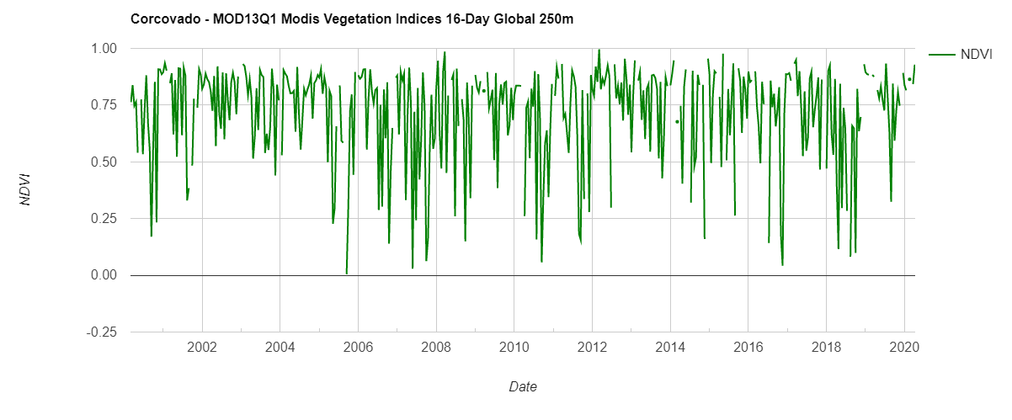
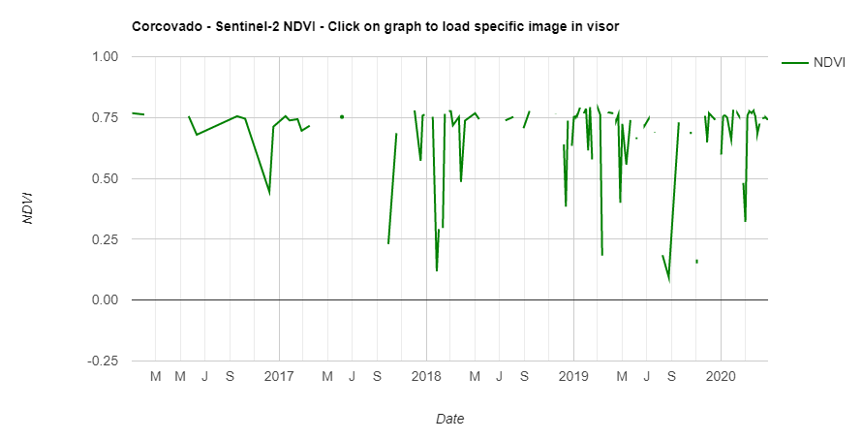
Forest - Broadleaf evergreen (Corcovado, Costa Rica)
Interpretation of NDVI graphs:
In both graphs the average is above 0,5 which means presence of healthy vegetation throughout the year.
The lack of annual fluctuations reflects the evergreen character of the forest.
The steep drops in the graph are a consequence of the clouds that cover the forest and satellites do not receive the reflection.

Slide 15
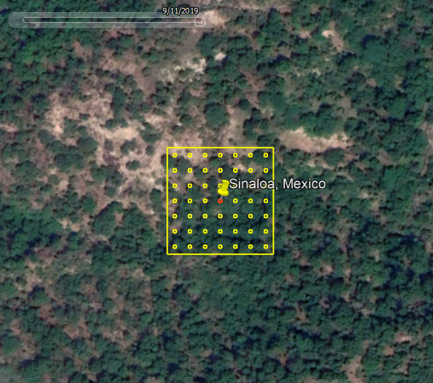
Forest - Broadleaf deciduous (Sinaloa, Mexico)
Category: Forest
Subcategory: Broadleaf deciduous
Description: In the plot and surroundings a semi-dense forest can be seen. The plot is in an arid area in the western part of the Sierra Madre Mountains in Mexico.
Year 2019
View in Google Earth
BEGINNER PLOT

Slide 16
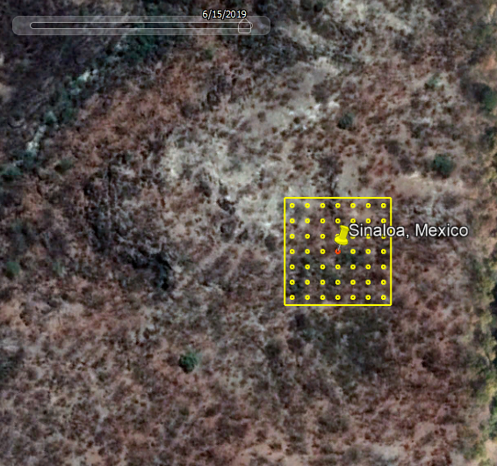
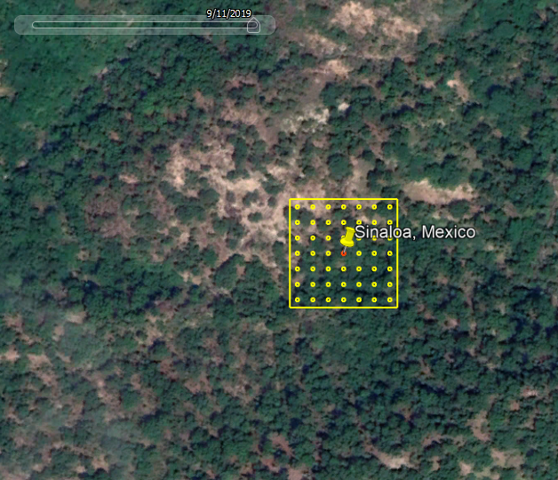
Forest - Broadleaf deciduous (Sinaloa, Mexico)
June 2019
September 2019
Between June and November 2019 the landscape and colors look different due to the fall of the leaves in the deciduous forest.

Slide 17
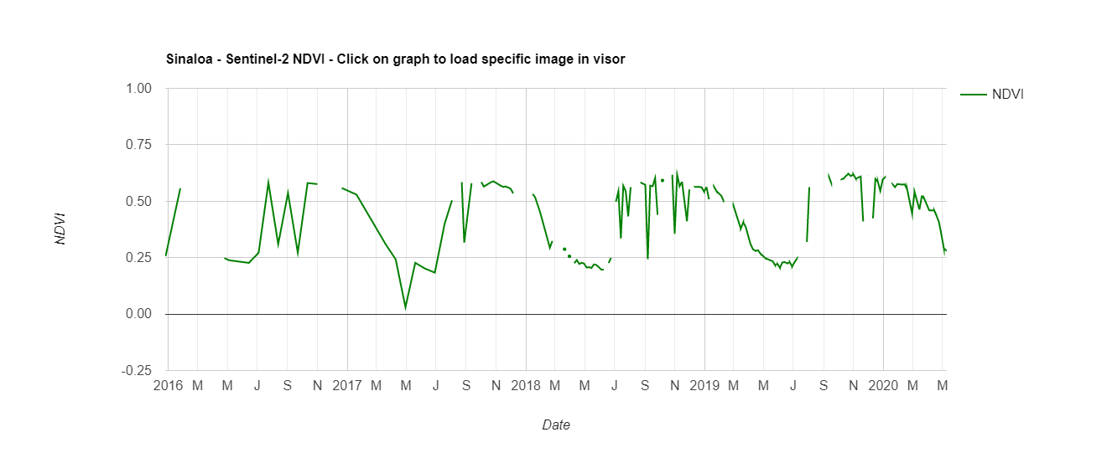
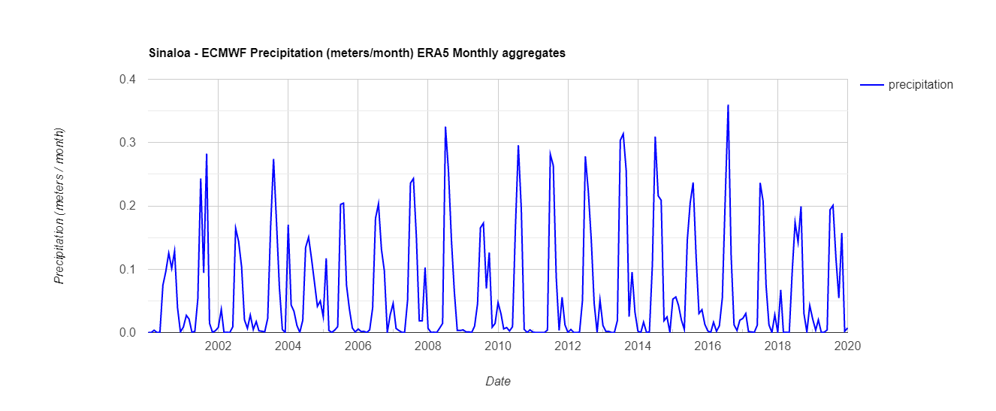
Forest - Broadleaf deciduous (Sinaloa, Mexico)
Interpretation of NDVI and precipitation graphics:
The NDVI graph shows that the highest NDVI value is above 0,5 and drops till 0,25 in the dry season.
The annual pattern reflects the deciduous character of the forest that match with the precipitation graphic.

Slide 18
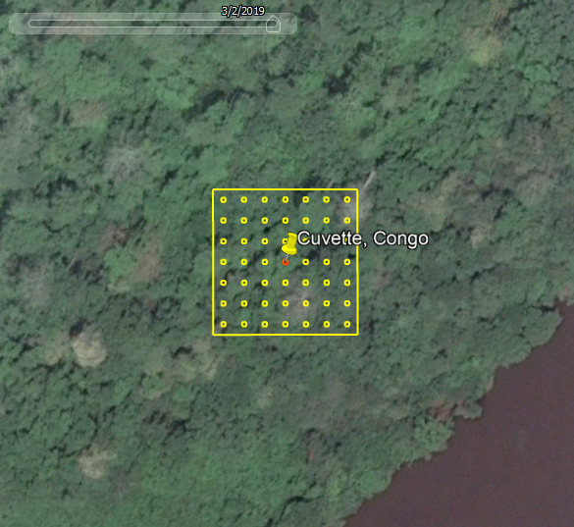
Forest - Broadleaf mixed (Cuvette, Congo)
Category: Forest
Subcategory: Broadleaf mixed
Description: The plot is located close to the Congo river.
Nevertheless, it is not a riparian forest because it does not look like a transition zone between the terrestrial and aquatic environment.
Year 2019
ADVANCED PLOT
View in Google Earth

Slide 19
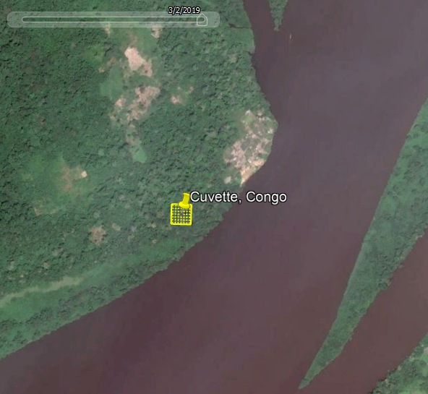
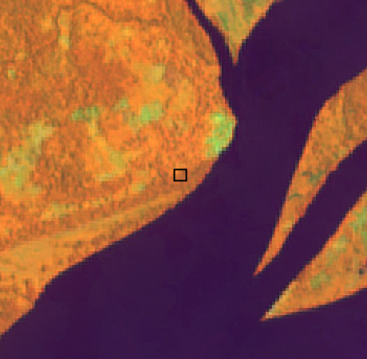
Forest - Broadleaf mixed (Cuvette, Congo)
Image with human visible bands
Image with false color bands
Real color image on the left side and false color image (Sentinel 2 composite of last12 months) on the right side in comparison. In the Sentinel 2 image water is represented in dark blue, vegetation in orange and a village on the sidelines of the river in green.

Slide 20
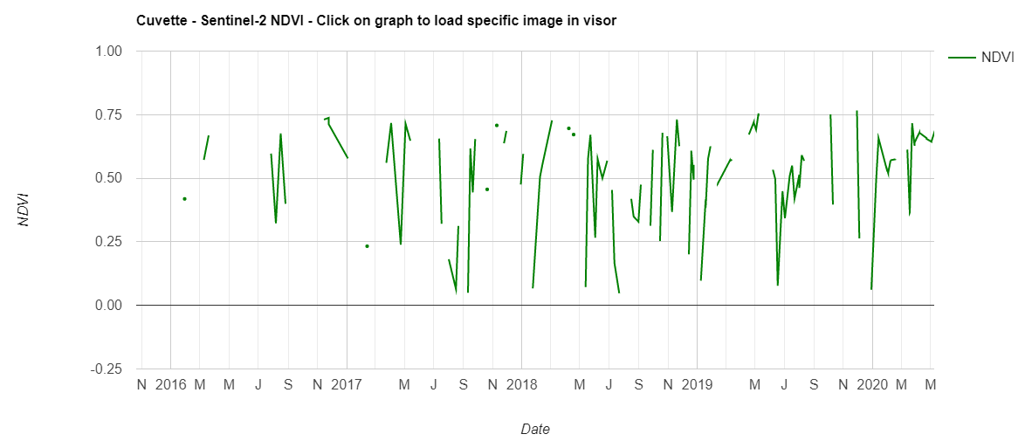
Forest - Broadleaf mixed (Cuvette, Congo)
Interpretation of NDVI graph:
The average is above 0,5 which means presence of healthy vegetation throughout the year.
The slightly recognizable annual pattern reflects the mixed character of the forest.
Like in the broadleaf evergreen forest, the steep drops in the graph are a consequence of the clouds that cover the forest.

Slide 21
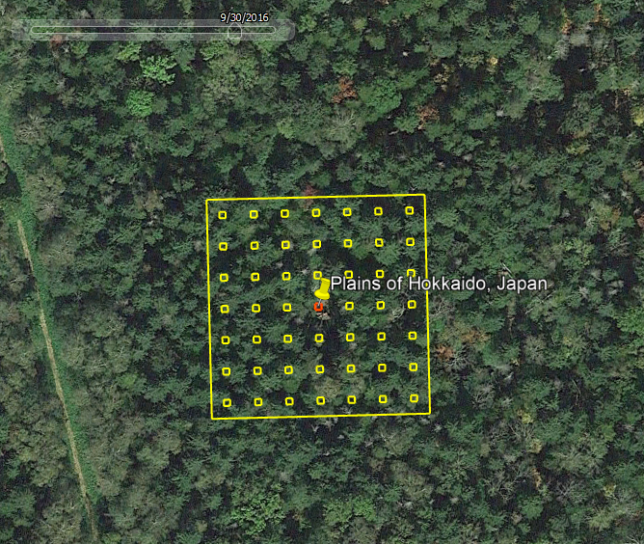
Forest – Mixed forest (brod-con) (Hokkaido, Japan)
Category: Forest
Subcategory: Mixed forest (brod-con)
Description: The plot is located in the plains of Hokkaido in Japan. The satellite image suggests the presence of coniferous and broadleaf species in the forest.
Year 2016
View in Google Earth
ADVANCED PLOT

Slide 22
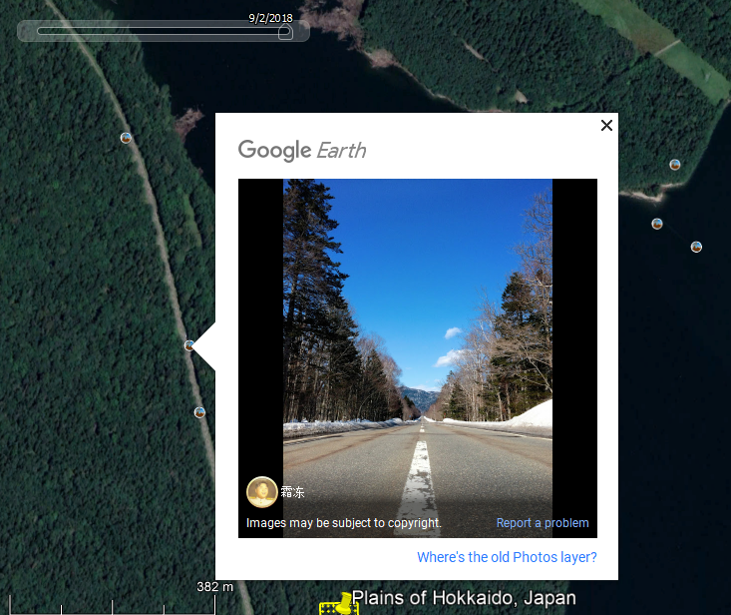
Forest – Mixed forest (brod-con) (Hokkaido, Japan)
The Google Earth pictures can be very helpful for the identification of land use categories and especially subcategories. In this picture the coniferous and deciduous trees that compose the mixed forest can be seen in the winter time.

Slide 23
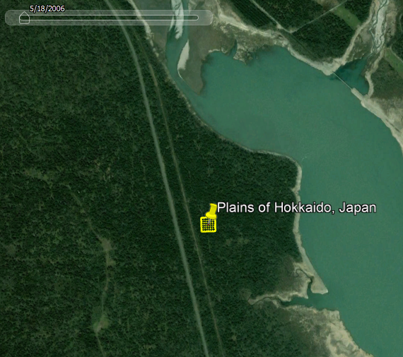
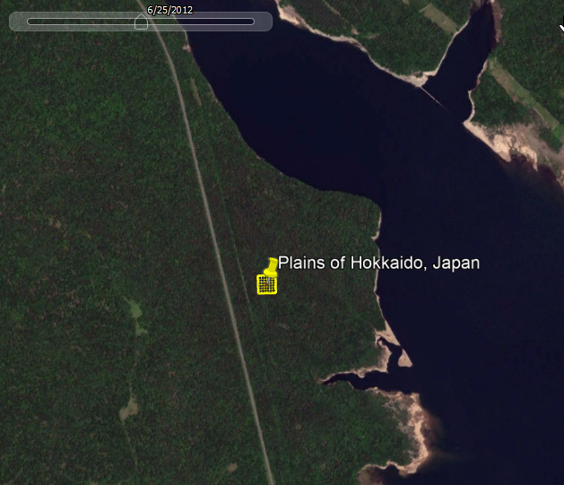
Forest – Mixed forest (brod-con) (Hokkaido, Japan)
Year 2006
Year 2012
Land use change: Since 2000 (using NDVI graohs) no changes perceived in terms of forest area and density. The image on the right side in June 2012 shows how the color of the leaves start to turn red.

Slide 24
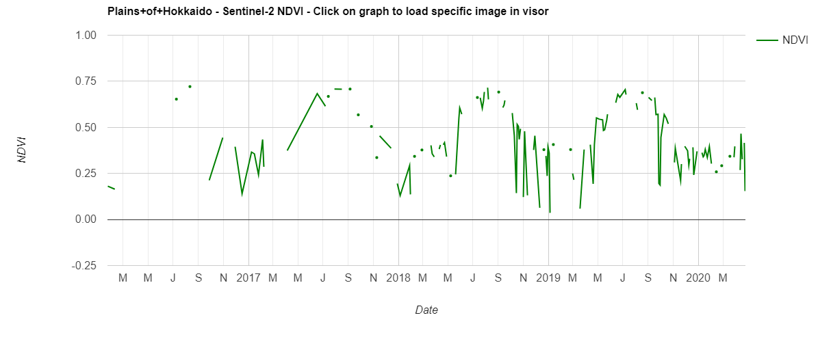
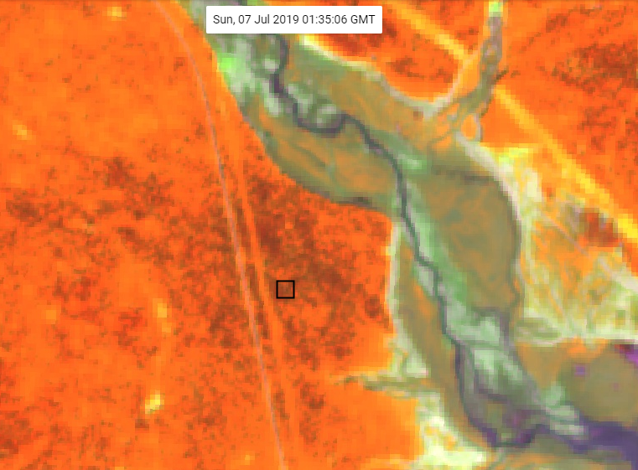
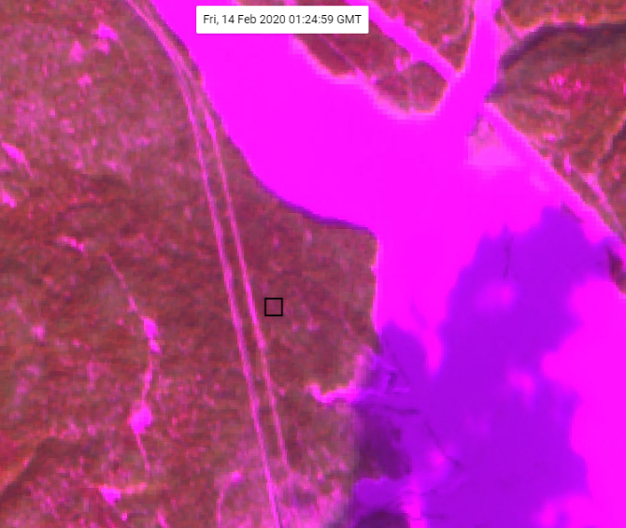
Forest – Mixed forest (brod-con) (Hokkaido, Japan)
Interpretation of NDVI graphs and images:
The NDVI graph shows that the highest NDVI value is above 0,5 and drops till 0,25 when a part of the forest loses its leaves or when the forest is covered by snow.
On the left image in July, the forest is represented in orange as a sign of healthy vegetation.
On the right image the forest is brownish, and the path and lake are pink/purple because covered with snow.

Slide 25
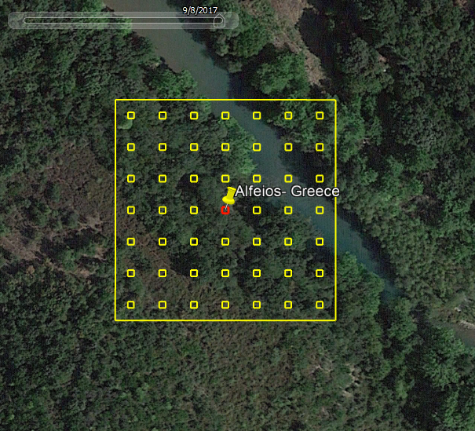
Forest – Riparian forest (Alfeiós, Greece)
Category: Forest
Subcategory: Riparian forest
Description: The plot is located adjacent to the Alfeiós which is the longest river in the Peloponnese, in Greece.
Riparian zones are transition zones between an upland terrestrial environment and an aquatic environment.
Year 2017
View in Google Earth
BEGINNER PLOT

Slide 26
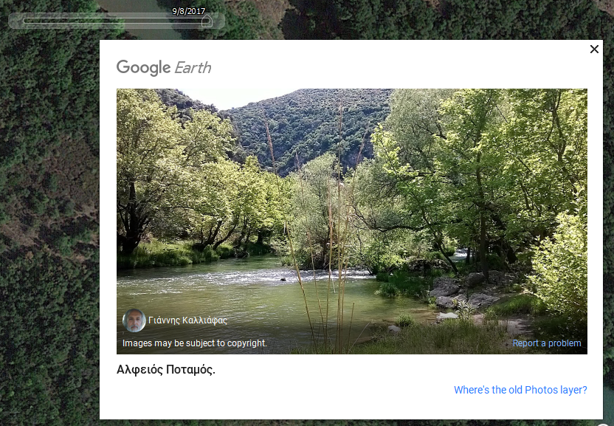
Forest – Riparian forest (Alfeiós, Greece)
In this picture riparian forest species (Salix etc.) can be appreciated.

Slide 27
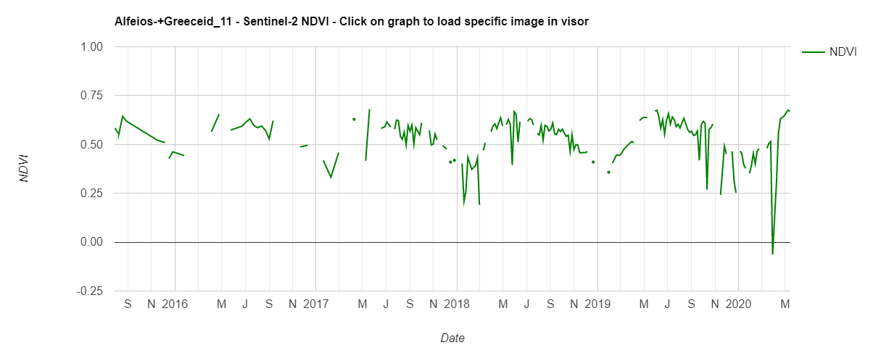
Forest – Riparian forest (Alfeiós, Greece)
Interpretation of NDVI graph:
The average is above 0,5 which means presence of healthy vegetation throughout the year.
This riparian forest is deciduous that is why it fluctuates as year seasons change.

Slide 28
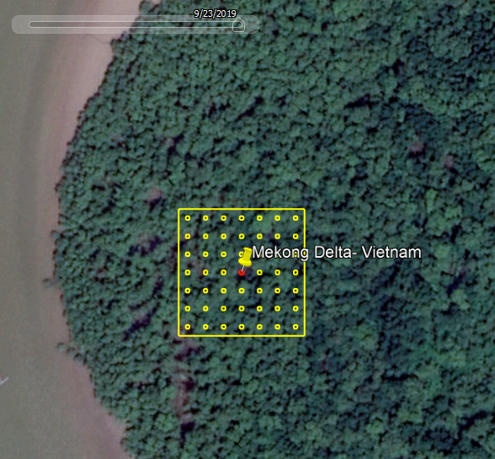
Forest – Mangrove forest (Mekong Delta, Vietnam)
Category: Forest
Subcategory: Mangrove forest
Description: The plot is located in the Mekong Delta.
Mangrove forests grow on coastal intertidal zones in tropical and subtropical latitudes.
Year 2019
ADVANCED PLOT
View in Google Earth

Slide 29
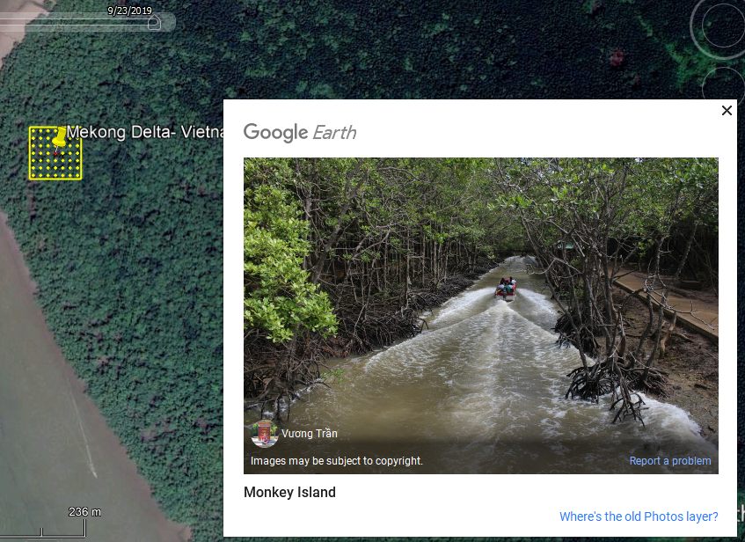
Forest – Mangrove forest (Mekong Delta, Vietnam)
In this picture the mangrove species can be appreciated. They are easy to recognize due to their particular roots system.

Slide 30
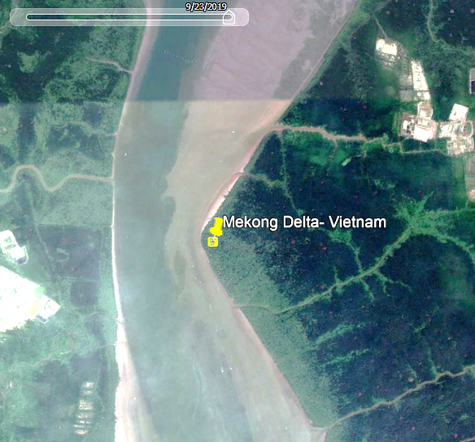
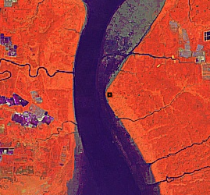
Forest – Mangrove forest (Mekong Delta, Vietnam)
Image with human visible bands
Image with false color bands
Year 2019
Real color image on the left side and false color image (Sentinel 2 composite of last12 months) on the right side in comparison. In the Sentinel 2 image vegetation is represented in orange and mangroves are easy to spot due to the fact that the orange color is very strong. Water is represented in dark blue.

Slide 31
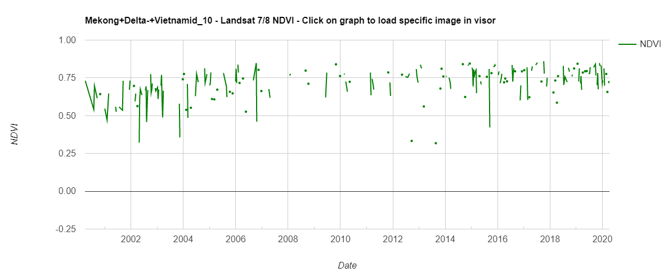
Forest – Mangrove forest (Mekong Delta, Vietnam)
Interpretation of NDVI graph:
The average is above 0,5 which means presence of healthy vegetation throughout the year. Mangroves are evergreen forests.
Like in the broadleaf evergreen forest, the steep drops in the graph are a consequence of the clouds that cover the forest.

Slide 32
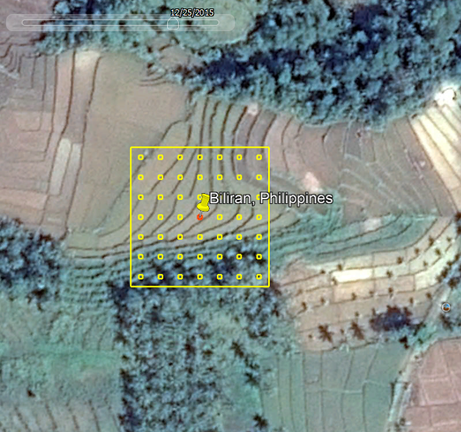
Cropland – Rice paddy (Biliran, Philippines)
Category: Cropland
Subcategory: Rice paddy. Annual crop
Description: The presence of terraces makes it very easy to identify paddy fields. These rice fields are located in a mountainous region in Biliran Island in the Philippines.
Year 2015
BEGINNER PLOT
View in Google Earth

Slide 33
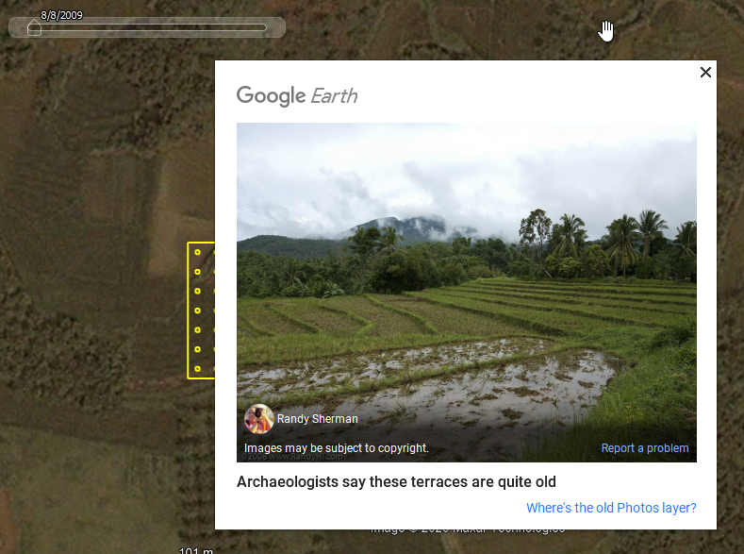
Cropland – Rice paddy (Biliran, Philippines)
The Google Earth pictures can be very helpful for the identification of land use categories and especially subcategories. In this pictures we see the paddy fields and the watered terraces.

Slide 34
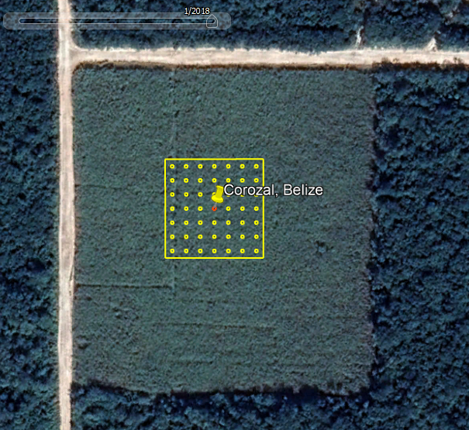
Cropland – Permanent crop, Sugarcane (Corozal, Belize)
Category: Cropland
Subcategory: Land under permanent crop. Annual crop. Sugarcane
Description: In the satellite image we see a cropland surrounded by forest and big roads that reveal the existence of deforestation and extensive farming systems.
Year 2018
Year 2020
View in Google Earth
BEGINNER PLOT

Slide 35
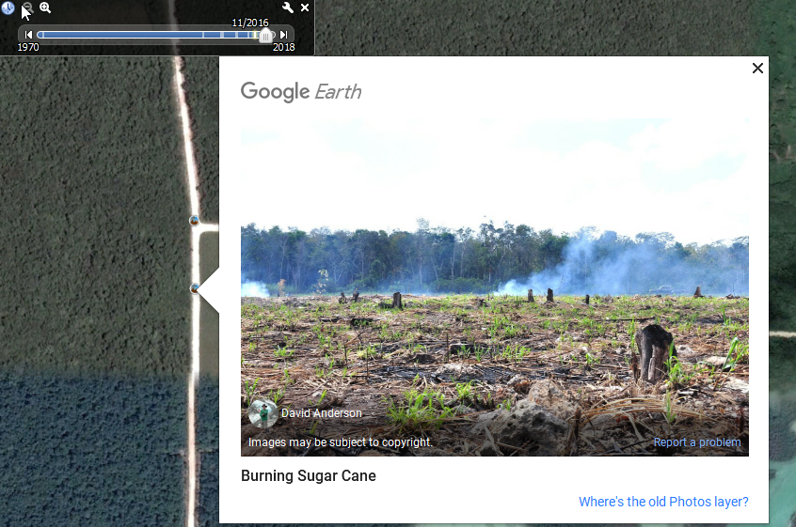
Cropland – Permanent crop, Sugarcane (Corozal, Belize)
The Google Earth pictures can be very helpful for the identification of land use categories and especially subcategories. In this pictures we see a burned sugar cane field.

Slide 36
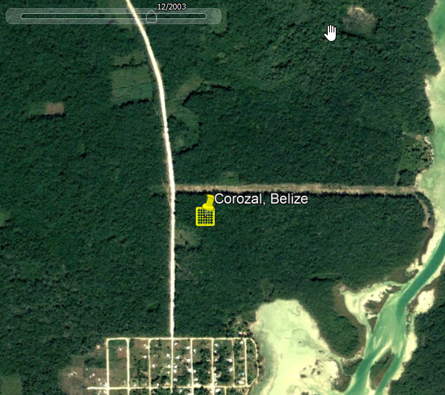
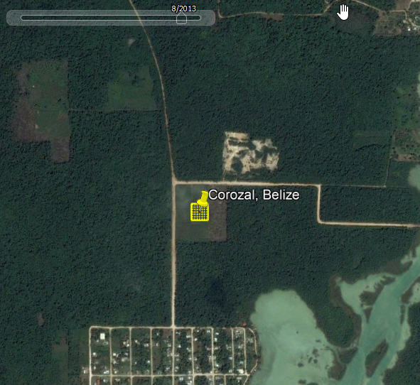
Cropland – Permanent crop, Sugarcane (Corozal, Belize)
Year 2003
Year 2013
Land use changes in time: Between 2003 and 2013 we see a land use change in our plot. In 2003 the land use was forest. It was converted to cropland in 2011.

Slide 37
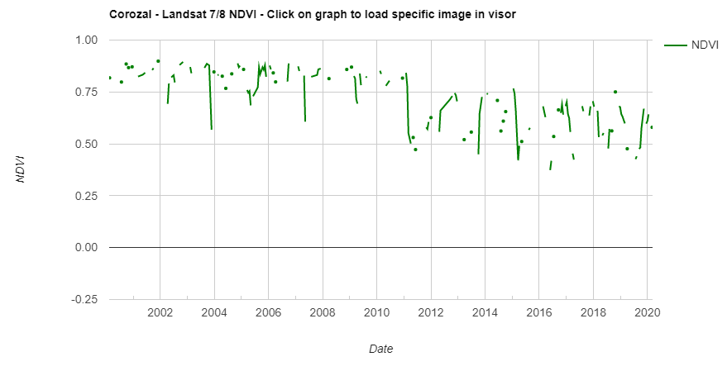
Cropland – Permanent crop, Sugarcane (Corozal, Belize)
Interpretation of NDVI graphics:
Conversion from forest to cropland as seen in imagery. Change occurs in 2011.

Slide 38
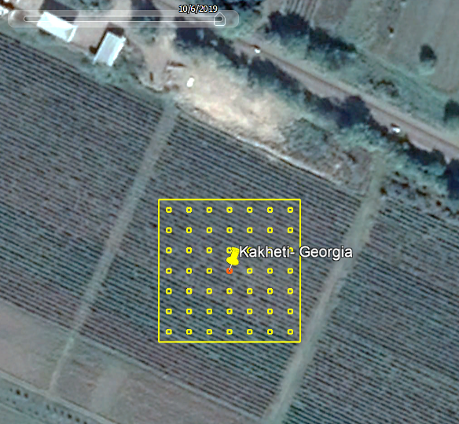
Cropland – Orchard, Vineyard (Kakheti, Georgia)
Category: Cropland
Subcategory: Orchard. Perennial crop. Vineyard
Description: In the Google Earth image we see a vineyard that can be identified due to its particular row spacing scheme.
Kakheti is the oldest and most important wine region in Georgia.
Year 2019
View in Google Earth
BEGINNER PLOT

Slide 39
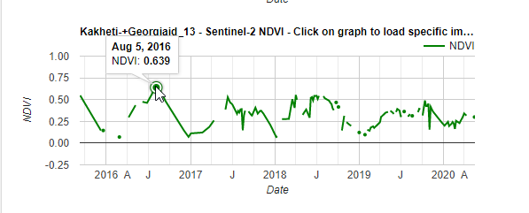
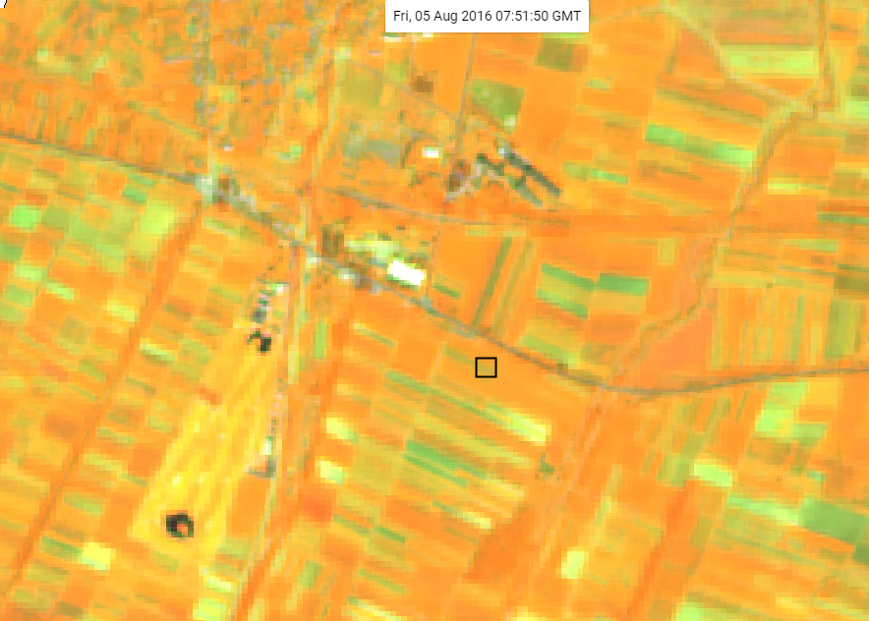
Cropland – Orchard, Vineyard (Kakheti, Georgia)
Interpretation of NDVI graphic:
Looking at the graphic, we will see that vineyards have a particular growing pattern with its highest peak in the summer months and drops after the grapes harvest.
The picking and pressing of grapes in Georgia's main wine-producing region, Kakheti, lasts from about 20 September to 20 October. The vegetation intensity can vary according to the yearly climatic conditions.

Slide 40
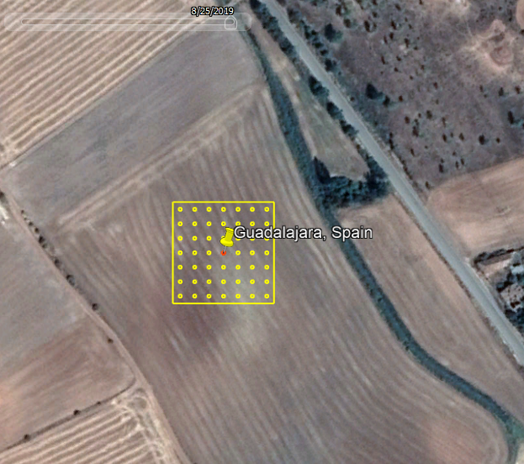
Cropland – Permanent crop, Cereal (Guadalajara, Spain)
Category: Cropland
Subcategory: Land under permanent crop. Annual crop.
Cereal
Description: The bright yellow colors and parallel stripes after the harvest make it easy to identify cereal plantations such as wheat, oat, barley or spelt. These are rainfed plantations.
Year 2019
View in Google Earth
ADVANCED PLOT

Slide 41


Cropland – Permanent crop, Cereal (Guadalajara, Spain)
Year 2009
Year 2019
Land use changes in time: In this area farmers rotate crop systems such as cereals, sunflowers and legumes in order to obtain benefits for the soil.

Slide 42


Cropland – Permanent crop, Cereal (Guadalajara, Spain)
Interpretation of NDVI and precipitation graphics:
NDVI fluctuates reaching 0,5 in the spring when plantations are in its growing phase and drops down in the summer when farmers harvest their land.
Maximum NDVI value is 0,5 denoting a rainfed crops. Usually irrigated crops will have higher NDVI values
The graphs shows that the plantation in this particular field might not have been the same in 2017, 2018 and 2019 and 2020, as NDVI curves behave differently.
Maximum precipitations fall in the spring months.

Slide 43


Cropland – Permanent crop, Cereal (Guadalajara, Spain)
Interpretation of Sentinel 2 composite images (20 m resolution) showing the vegetation intensity (orange is high vegetation intensity and green is low vegetation intensity): The image in May 2017 shows its vegetation in its maximal intensity. In the image on the right in June 2017 the vegetation intensity is very low after the harvest.

Slide 44

Cropland – Palm (West Sepik, PNG)
Category: Cropland
Subcategory: Perennial crop. Palm. Coconut
Description: This forest located in Papua New Guinea looks like a broadleaf evergreen forest.
The land use change from forest to oil palm plantation cannot be appreciated with Google Earth images because the last satellite image available in the GE repository is from the year 2014.
Year 2014
View in Google Earth
ADVANCED PLOT

Slide 45


Cropland – Palm (West Sepik, PNG)
Year 2013
Year 2014
Land use changes in time: Between 2013 and 2014 we can see that big roads were built within the forest.

Slide 46



Cropland – Palm (West Sepik, PNG)
Interpretation of NDVI and precipitation graphics:
The NDVI values in the Landsat and MODIS graphs reflect the evergreen character of the forest until the year 2015.
In 2015 a steep vegetation drop can be read in both graphs. This happened after the fields for the oil palm plantations were cleared down. If we look at Landsat images in April 2015 we can clearly identify the cleared parts of the forest.

Slide 47

Grassland – Grassland with trees and shrubs (Western Rwanda, Rwanda)
Category: Grassland
Subcategory: Grassland with trees and shrubs
Description: The plot is located in a hilly region in Western Rwanda at 2660 m altitude. The fences suggest the presence of grazing.
The difference between tree and shrub is very clear in this grassland. The one tree on the left upper side of the plot is very high and the shade can be recognized easily.
Year 2019
View in Google Earth
BEGINNER PLOT

Slide 48

Grassland – Grassland with trees and shrubs (Western Rwanda, Rwanda)
In this case the Google Earth picture shows the hilly nature of the terrain and the healthy grassland vegetation.

Slide 49


Grassland – Grassland with trees and shrubs (Western Rwanda, Rwanda)
Year 2006
Year 2019
Land use changes in time: No changes in the land use identified.

Slide 50

Grassland – Grassland with trees and shrubs (Western Rwanda, Rwanda)
Interpretation of NDVI graphic:
NDVI ranges between 0,75 and 0,5. This is a sign of a grassland with healthy vegetation.

Slide 51

Grassland – Grassland (Southland, New Zealand)
Category: Grassland
Subcategory: Grassland
Description: The plot is located in the southern part of New Zealand. From the color of the grassland we can see that the vegetation intensity is very high.
Year 2019
View in Google Earth
BEGINNER PLOT

Slide 52

Grassland – Grassland (Southland, New Zealand)
Google Earth pictures nearby show that we are talking about pasturelands for sheep.

Slide 53


Grassland – Grassland (Southland, New Zealand)
Image with natural bands (RGB)
Image with false color bands
Natural color image on the left side and false color image (Sentinel 2 composite of last12 months) on the right side in comparison. In the Sentinel 2 image vegetation is represented in orange.

Slide 54

Grassland – Grassland (Southland, New Zealand)
Interpretation of NDVI graphic:
NDVI ranges between 0,5 and 0,75. This is a sign of a grassland with healthy vegetation.
The steep drops in the graph are a consequence of the clouds.

Slide 55

Grassland – Grassland with trees (Serengeti, Tanzania)
Category: Grassland
Subcategory: Grassland with trees
Description: The plot is located in the Serengeti National Park in Tanzania.
In this case it is easy to differentiate between trees and bushes when zooming out and activating the historical images.
Year 2019
View in Google Earth
BEGINNER PLOT

Slide 56


Grassland – Grassland with trees (Serengeti, Tanzania)
Year 2010
Year 2016
Land use changes in time: The difference between the image on the left in August 2010 and the one on the right in September 2016 is the vegetation intensity of the grassland. In the images we can see degraded soils due to possible fire events and paths used by wild animals.

Slide 57

Grassland – Grassland with trees (Serengeti, Tanzania)
Interpretation of NDVI graphic:
NDVI ranges between 0,25 and 0,75 This is a sign of a grassland with healthy vegetation. NDVI graph shows growing phases of grass that depends on precipitation.

Slide 58

Grassland – Shrubland (La Palma, Spain)
Category: Grassland
Subcategory: Shrubland
Description: This plot is located in the Caldera de Taburiente National Park, a national park on the island of La Palma, Canary Islands in Spain.
Year 2019
ADVANCED PLOT
View in Google Earth

Slide 59

Grassland – Shrubland (La Palma, Spain)
In this case the Google Earth picture shows the shrubs with the yellow flowers that are typical for this region in the island of La Palma.

Slide 60


Grassland – Shrubland (La Palma, Spain)
Year 2000
Year 2018
Year 2018
Land use changes in time: In the winter months the territory is a lot drier (left image). In July the yellow flowers of the shrub can be seen in the satellite image (right image).

Slide 61


Grassland – Shrubland (La Palma, Spain)
Image with human visible bands
Image with false color bands
Natural color image on the left side and false color image (Sentinel 2 composite of last 12 months) on the right side in comparison. The images show how vegetation intensity changes in accordance to the altitude.

Slide 62

Grassland – Shrubland (La Palma, Spain)
Interpretation of NDVI graphic:
NDVI values are constant around 0,3 and 0,5. This is a sign of a shrubland with healthy vegetation and little seasonal changes.

Slide 63

Grassland – Grassland with trees (Mato Grosso, Brazil)
Category: Grassland
Subcategory: Grassland with trees
Description: In the plot we can see a grassland with some palm trees.
Year 2019
View in Google Earth
ADVANCED PLOT

Slide 64



Grassland – Grassland with trees (Mato Grosso, Brazil)
FIRST Land use change: Between 2000 and 2001 we see a land use change from forest to cropland. The forest is cleared and the area is used as grassland or cropland. The conversion in the full area is even clearer when looking at the 2004 Landsat 7 yearly mosaic

Slide 65



Grassland – Grassland with trees (Mato Grosso, Brazil)
Year 2010
Year 2012
Year 2019
SECOND Land use change: Between 2010 and 2019 we see a land use change from cropland to grassland. Palm tree plantations converted to grassland with trees within 9 years. The area is now used for cattle.

Slide 66


Grassland – Grassland with trees (Mato Grosso, Brazil)
Year 1985
Year 2016
Land use changes in time: Land use between1985 and 2016 has changed from forest (through cropland) to grassland within the plot and all around the area where the Amazon forest has been massively deforested.

Slide 67

Wetland – Lagoon (Rio de Janeiro, Brazil)
Category: Wetland
Subcategory: Lagoon
Description: The plot is located in a coastal nature preserve located in neighborhoods of Rio de Janeiro, Brazil.
Year 2019
View in Google Earth
BEGINNER PLOT

Slide 68

Wetland – Lagoon (Rio de Janeiro, Brazil)
In this case the Google Earth picture shows an areal picture of the lagoon.

Slide 69

Wetland – Lagoon (Rio de Janeiro, Brazil)
Interpretation of Sentinel 2 composite images (20 m resolution):
In these Sentinel 2 composite images water is represented in black.
The plot is located in the lagoon surrounded by areas with healthy vegetation. In the upper part of the image the coastline and the sea can be recognized.

Slide 70


Wetland – Lagoon (Rio de Janeiro, Brazil)
Interpretation of NDVI graphic:
Negative values of NDVI (values approaching -1) correspond to water. In this case NDVI values above 1 appear when clouds are covering the area.

Slide 71

Wetland – Seasonal river (Ghaggar, India)
Category: Wetland
Subcategory: Seasonal river
Description: The plot is located in the Ghaggar river which is an intermittent river in India that flows during the monsoon rains.
Year 2006
View in Google Earth
ADVANCED PLOT

Slide 72

Wetland – Seasonal river (Ghaggar, India)
In this case the Google Earth picture shows a bridge that crosses the river in front of the plot and will influence the rivers water regime.

Slide 73


Wetland – Seasonal river (Ghaggar, India)
Year 2015
Year 2018
Land use changes in time: The river flows with water only in the rainy season as seen in the left side and dries up the rest of the year as seen in the image on the right side.

Slide 74

Wetland – Seasonal river (Ghaggar, India)
Interpretation of NDVI graphic:
NDVI values are so high because vegetation might cover the river bed when it is not covered by water. Based on the NDVI graph the water does not often flow in the river only in the monsoon period (NDVI values lower than 0).

Slide 75

Wetland – Permanent river (Nyabarongo, Rwanda)
Year 2017
Category: Wetland
Subcategory: Permanent river
Description: The plot is located in the Nyabarongo river, the longest river entirely flowing in Rwanda.
ADVANCED PLOT
View in Google Earth

Slide 76

Wetland – Permanent river (Nyabarongo, Rwanda)
Interpretation of Sentinel 2 NDVI image (20 m resolution):
In this Sentinel image water is represented in purple. The color of the water is purple and not black/dark blue due to the fact that it is a river with shallow waters.
The river is surrounded by areas with healthy vegetation that are represented in orange (orange is high vegetation intensity and green is low vegetation intensity).

Slide 77


Wetland – Permanent river (Nyabarongo, Rwanda)
Interpretation of NDVI graphic:
Negative values of NDVI correspond to water. In this case NDVI values above 0 appear when clouds are covering the area. Also probably due to the fact that the river is transporting sediment NDVI values are not constantly negative.

Slide 78

Wetland – Salt extraction (Qoqek, China)
Category: Wetland
Subcategory: Salt extraction
Description: The plot is located in an arid area in the northern part of China. Without zooming out the terrain looks like a very dry soil or a salty soil.
Year 2005
View in Google Earth
ADVANCED PLOT

Slide 79



Wetland – Salt extraction (Qoqek, China)
Year 2000
Year 1984
Land use changes in time:
It used to be a seasonal salt lake. Now it is being used to extract salt as can be seen in the last image in the year 2016.
Year 2007
Year 2016

Slide 80


Wetland – Salt extraction (Qoqek, China)
Interpretation of NDVI and precipitation graphic:
Values close to 0 mean no vegetation like in this arid area.
In this case we are considering the low spatial resolution (250m) MODIS graph because the area around the plot is homogeneous.
The NDVI values drop to minus 0 when the lake is covered by water.
Precipitation is extremely low as the plot is located in an arid area.

Slide 81

Wetland – Peatland (Muyaga, Rwanda)
Category: Wetland
Subcategory: Peatland
Description: This plot in Rwanda is located in a peatland which is basically an area of land with layers of accumulated organic surface material in a state of decay (known as peat).
This area is used for extraction of peat for energy production.
Year 2020
ADVANCED PLOT
View in Google Earth

Slide 82



Wetland – Peatland (Muyaga, Rwanda)
Year 2016
Year 2007
Year 2019
Year 2007
Land use changes in time: Between 2007 and 2019 the area around this plot changed in many aspects. In 2007 it was used for small holder agriculture and between 2016 and 2019 a power plant was built in the southern tip of the bog and the area is used for extraction of peat for electricity generation.

Slide 83


Wetland – Peatland (Muyaga, Rwanda)
Interpretation of NDVI graphic and Sentinel 2 NDVI image (20 m resolution):
The land use conversion can be observed from the NDVI graph. Before 2016 the land use was agriculture (high NDVI values, high vegetation intensity). The peatland extraction commenced as the power plant was build.
The Sentinel 2 false color mosaic shows the peatland in green (no vegetation) and the power plant in white/yellow. On the right side the river in purple and agricultural plantations in orange (vegetation) over the border with Burundi.

Slide 84

Settlement – City (Essaouira, Morocco)
Category: Settlement
Subcategory: City
Description: The plot is located in the old medina of the coastal city of Essaouira in Morocco.
Year 2020
View in Google Earth
BEGINNER PLOT

Slide 85


Settlement – City (Essaouira, Morocco)
Year 2007
Year 2020
Land use changes in time: In the medina of the city, no land use change would be expected as the city has been occupied since prehistoric times.

Slide 86

Settlement – City (Essaouira, Morocco)
Interpretation of NDVI graphic:
NDVI values close to and above 0 are expected as in this part of the city no trees are found. The variation of the value is due to differences on the illumination of the images (taken at different times of the day or affected by the seasonal tilting of the sun), shades and clouds.

Slide 87


Settlement – Infrastructure (Hamburg, Germany)
Category: Settlement
Subcategory: Infrastructure
Description: The plot is located in the port in Hamburg on the sidelines of the Elbe river.
Year 2019
View in Google Earth
BEGINNER PLOT

Slide 88


Settlement – Infrastructure (Hamburg, Germany)
Interpretation of NDVI graphs:
Sentinel 2 (20 m pixel): NDVI values close to 0 concords with the VHR images from Google Earth. Variation due to clouds/shades and illumination conditions.
MODIS (250 m pixel): NDVI values between 0 and 0,25 means the surroundings of the plot with green areas are also being considered.

Slide 89

Settlement – Mining (North Rhine Westphalia, Germany)
Category: Settlement
Subcategory: Mining
Description: The plot is located in the Hambach coal mine in North Rhine Westphalia.
Year 2018
View in Google Earth
BEGINNER PLOT

Slide 90

Settlement – Mining (North Rhine Westphalia, Germany)
In this case the Google Earth picture shows the landscape in Hambach coal mine which is the largest open pit mine in Germany.

Slide 91


Settlement – Mining (North Rhine Westphalia, Germany)
Year 2007
Year 2018
Land use changes in time: The mine is on the site of the ancient Hambach Forest which was purchased in 1978. The forest was cut down and cleared into a mine.

Slide 92

Settlement – Mining (North Rhine Westphalia, Germany)
Interpretation of NDVI graph:
NDVI values in the graph reflect the land use change from forest to bare soil in 2012. NDVI values slowly drop and start approaching close to 0 values.

Slide 93

Settlement – Village (Island, Lake Chad)
Category: Settlement
Subcategory: Village
Description: The plot is located in a little village in one of the Lake Chad Islands.
Housing and bare soil can be seen within the plot.
Year 2012
ADVANCED PLOT
View in Google Earth

Slide 94


Settlement – Village (Island, Lake Chad)
Year 2009
Year 2012
Land use changes: Between 2009 and 2012, the village got smaller and its inhabitants built a fence around the settlements. In the last image the village seems to be affected by a flooding, no land use change.

Slide 95

Settlement – Village (Island, Lake Chad)
Interpretation of NDVI graphic:
The NDVI values range between 0 and 0,3. The village is located on a grassland with vegetation that fluctuates with the rainy and dry seasons. The area is affected by fires and floodings.

Slide 96

Settlement – Urban Park (London, UK)
Category: Settlement
Subcategory: Urban Park
Description: The plot is located in a famous urban park, the Hyde park in London. Even though an urban park has a green cover it would be categorized as a settlement.
Year 2019
ADVANCED PLOT
View in Google Earth

Slide 97

Settlement – Urban Park (London, UK)
Interpretation of NDVI graph:
The NDVI values range between 0,3 and 0,5. The urban park is covered by grassland with trees and fluctuates depending on weather seasonality.

Slide 98

Otherland – Snow (Arusha, Tanzania)
Category: Other land
Subcategory: Snow
Description: The plot is located on Mt-Kilimanjaro in Arusha, Tanzania close to the crater of an inactive volcano at 5779m altitude.
Year 2019
BEGINNER PLOT
View in Google Earth

Slide 99

Otherland – Snow (Arusha, Tanzania)
In this case the Google Earth picture shows an areal image of the Mt- Kilimanjaro covered with snow.

Slide 100


Otherland – Snow (Arusha, Tanzania)
February 2003
August 2017
The area is covered by snow in both winter and summer seasons

Slide 101

Otherland – Snow (Arusha, Tanzania)
Interpretation of NDVI graphic:
NDVI values are below 0 throughout the year indicating that the area is permanently covered with snow.

Slide 102

Otherland – Sand (Easter Island, Chile)
Category: Other land
Subcategory: Sand
Description: The plot is located on a beach in the Eastern Island in the middle of the Pacific.
Year 2020
BEGINNER PLOT
View in Google Earth

Slide 103
Otherland – Sand (Easter Island, Chile)
Image with human visible bands
Image with false color bands
Land use change: In these Sentinel 2 composite images water is represented in black, vegetation in orange and sand in withe. No land use change can be perceived.

Slide 104

Otherland – Sand (Easter Island, Chile)
Interpretation of NDVI graphic:
NDVI values are slightly above 0. These values represent bare soil or sand. The peaks are usually caused by clouds or sun reflection

Slide 105

Otherland – Dune (Mingsha Shan, China)
Category: Other land
Subcategory: Dune
Description: The plot is located in the middle of a gigantic sand dune in Mingsha Shan, China.
Year 2012
View in Google Earth
BEGINNER PLOT

Slide 106


Otherland – Dune (Mingsha Shan, China)
Year 2003
Year 2020
Land use change: High resolution satellite images from the area are available since 2003.

Slide 107


Otherland – Dune (Mingsha Shan, China)
Sentinel 2 image with false color bands
Interpretation of NDVI graphic and false color image:
NDVI values are slightly above 0. These values represent bare soil or sand. The presence of green and white in the false color image shows the lack of vegetation.

Slide 108

Otherland – Ice (Graham Land, Antarctica)
Category: Other land
Subcategory: Ice
Description: The plot is located in Graham Land in Antarctica.
Year 2019
BEGINNER PLOT
View in Google Earth

Slide 109


Otherland – Ice (Graham Land, Antarctica)
Year 2006
Year 2011
Land use change: The ice sheet has not changed since 2000.

Slide 110


Otherland – Ice (Graham Land, Antarctica)
Sentinel 2 image with false color bands
Interpretation of NDVI graphic and false color image:
NDVI values are below 0. These values represent water or ice.
Pink/Purple colors indicate the presence of snow or ice.

